Slide 1
Swapping in OS
Mr.Krish Ujeniya
216120316028
Guided by - Mr. Umang Shukla

Slide 2
Contents
1
2
3
4
Introduction
Importance
Working
in
OS
Comparison

Slide 3
1
Introduction

Slide 4
Swapping is a simple memory or process management method used by the operating system (O.S).
This method is dedicated to increasing the utilization of the processor by moving blocks of data in and out of the main memory.
This data and information are swapped between the main and the secondary memory to optimize memory utilization and increase the processing power.

Slide 5
In secondary memory, the place where the swapped-out process is stored is called swap space.
Although the process of swapping affects the performance of the system, it helps to run larger and more than one process.
This is the reason why swapping is also referred to as memory compaction.

Slide 6
Swap information with Python
Input :
import psutil.
​print("Swap Memory Information:")
print(psutil. swap_memory())
Output:
Swap Memory Information:
sswap(total=1, used=1, free=0, percent=0.0, sin=0, sout=0)

Slide 7
2
Importance

Slide 8
The purpose of the swapping in operating system is to access the data present in the hard disk and bring it to RAM so that the application programs can use it.
The thing to remember is that swapping is used only when data is not present in RAM.
swapping is to increase the degree of multiprogramming and increase main memory usage.

Slide 9
3
Working In OS

Slide 10
The process of swapping also forms a queue of temporarily suspended processes as the execution carries out with the newly arrived process. The concept of swapping consists of two more concepts, swap in and swap out.
Swap Out is the method of removing a process from the RAM and adding it to the Hard Disk.
swap in means, removing the program from the hard disk and placing it back into the main memory or the RAM.

Slide 11
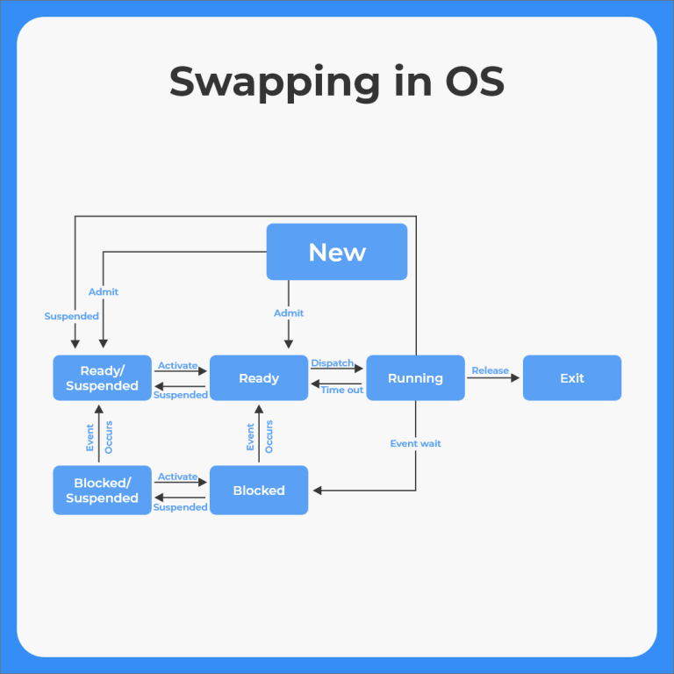

Slide 12
OS which uses Swapping
UNIX systems use a swapping mechanism if the main memory gets The system may discontinue swapping when the load on the processor drops.
Windows 3.1 is another operating system which uses swapping when the load on the processor is heavy.

Slide 13
Mobile OS Using Swapping
Mobile phone usually does not use the concept of swapping during their operation. The most popular mechanism used by them is flash memory which is more efficient than the hard drives used for persistent storage.
The flash memory can only be written a limited number of times before it becomes unreliable. Thus, the method is avoided to be used in the case of mobile devices.

Slide 14
Example
Suppose the user process's size is 2048KB and is a standard hard disk where swapping has a data transfer rate of 1Mbps. Now we will calculate how long it will take to transfer from main memory to secondary memory.

Slide 15
Answer
User process size is 2048Kb
Data transfer rate is 1Mbps = 1024 kbps
Time = process size / transfer rate
= 2048 / 1024
= 2 seconds
= 2000 milliseconds
Now taking swap-in and swap-out time, the process will take 4000 milliseconds

Slide 16
4
Comparison

Slide 17
Advantages of Swapping
The process helps the CPU to manage multiple processes within the same main memory.
The method helps to create and use Virtual Memory.
The method is economical.
Swapping makes a CPU perform several tasks simultaneously. Hence, processes do not have to wait for too long before they are executed.

Slide 18
Disadvantages of Swapping
In the case of heavy swapping activity, if the computer system loses power, the user might lose all the information related to the program.
If the swapping algorithm is not good, the overall method can increase the number of page faults and decline the overall processing performance.
Inefficiency may arise in the case where a resources or a variable is commonly used by the processes which are participating in the swapping process.

Slide 19
THANKS

